Slide 1
Case Study 2 – EDA & ML
Kosi Okeke
Notes:
Hello, my name is Kosi Okeke and I will be presenting my findings for Case Study 2 as well as showing what Machine Learning can do!

Slide 2
Agenda – What To Expect
Exploratory Data Analysis on Attrition Factors
A macro look at Age
Attrition Factors
Analysis of Trends Based on Job Role
Introduction to Job Role Analysis
Job Role-Specific Trends
Implications
Models for Attrition Prediction and Monthly Income Estimation
Introduction to Predictive Models
Description of Models
Model Performance and Validation
Conclusion
Summary of Key Findings
Notes:
First, an agenda and what to expect.

Slide 3
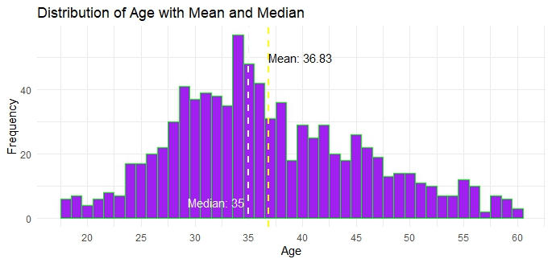
Breakdown of Employees by Age
Mean = 36.83
Median = 35
Min = 18
Max = 60
Standard Deviation = 8.93
Notes:
Yellow line = mean
White line = median

Slide 4
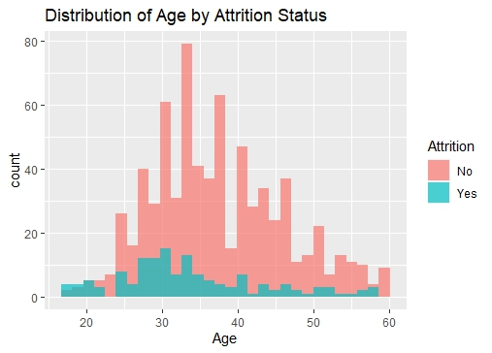
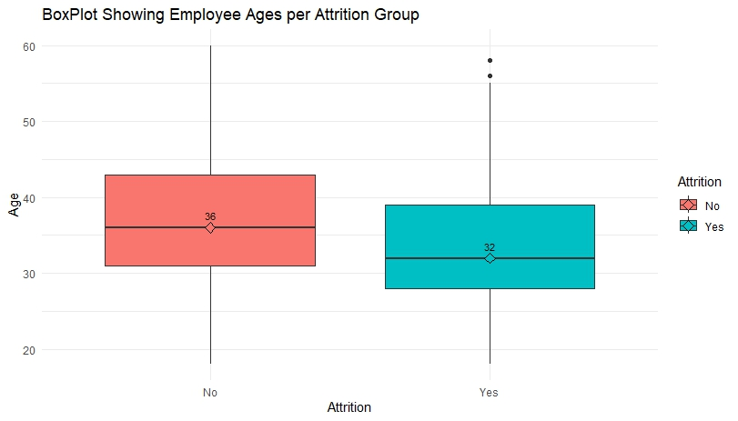
Attrition vs Age
Distribution looks normal enough, good variation.
Attrition group is younger on average than current employees.
Median = 36 for “No”
Median = 32 for “Yes”
Notes:
Here is that same distribution of number of employees for a given age broken up into the respective Attrition groups.
We can also look at the boxplot showing the various ages in each Attrition groups

Slide 5
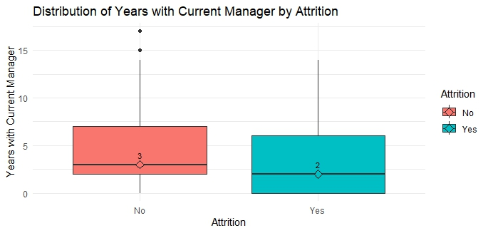
Attrition vs YearsWCurrentManager
The No group has a higher tenure on average under their current manager (p-value of 5.08e-6 from two sample t-test).
We are confident tenure under manager is related to Attrition (p-value of 0.0002581 from Pearson’s Chi-Squared).
Notes:
The two sampled t-test let’s us know which group has larger mean or if it is the same.
Pearson’s chi-squared can tell us whether two variables have an association with eachother

Slide 6
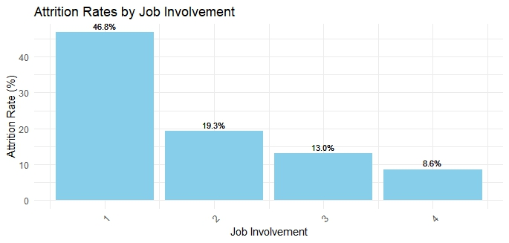
Attrition Rates vs Job Involvement
Looking at the relationship between Attrition and JobInvolvement:
As employee Job Involvement increases, the rate of attrition decreases.
What could this potentially mean?
Notes:
This could mean that as someone becomes more involved in their job, they will not see the need to leave.
People tend to stay the more fulfilling the job is.
There are probably other factors that tie in as well, but this is a good starting point.

Slide 7
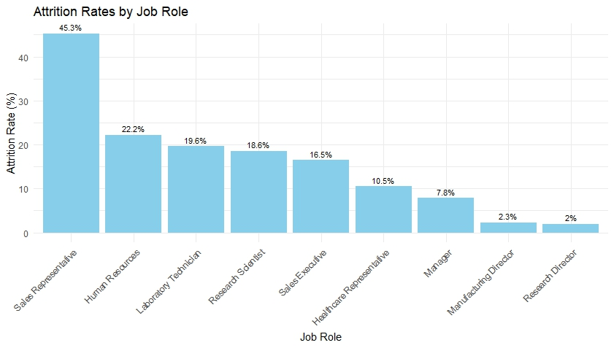
Job Role Analysis
Trends:
Max = Sales Rep (45.3%)
Min = Research Director (2%)
Reasons why?
Notes:
Sales Reps have high turnover. They must not see a need to stay with the company doing this role.
Maybe they can do it elsewhere for better pay.

Slide 8
Predictive Models
Objective?
We would like to build a prediction model that will successfully predict whether an employee will fall in the Attrition group.
We want to build a second model to estimate monthly income.
Approach?
Naïve Bayes: Calculates probability of Attrition based on certain predictors.
Linear Regression Model: Fits a linear equation to data to use for predicting future values.
Evaluation Criteria?
Naïve Bayes → 60% Sensitivity (True Positive Rate) and 60% Specificity (True Negative Rate)
Linear Model → RMSE < $3000

Slide 9
Predicting Attrition Naïve Bayes
To predict Attrition, we decided to build a Naïve-Bayes Model
80/20 random sample train/test split, ensuring robust model evaluation.
Results on Test Split
Accuracy = 89.08%
Sensitivity = 69.60%
Specificity = 92.05%
Notes:
Accuracy (89.08%): This high accuracy suggests that the model is very reliable.
Sensitivity (69.6%): this indicates that 69.6% of actual Attritioners were correctly identified by the model.
Specificity (92.05%): shows that the model correctly identified 92.05% of the group Attrition = Yes. The specificity and sensitivity suggest that the model can be used to estimate employees who may leave.

Slide 10
Estimating Monthly Income Linear Regression
To estimate monthly income, we are using a linear model.
A specific algorithm to choose our explanatory variables (Forward Selection) was utilized.
An 80/20 random sample train/test split was again used.
Results on Test Split
RMSE = 1072
10-fold CV yielded a RMSE of 992.4346 giving confidence that our model’s predicted values will deviate from the actual by an average of < $3000 RMSE.
Notes:
To estimate monthly income a linear model was used that yielded an RMSE (Root Mean Square Error) of 1072 on our Test Split. After running 10-fold CV it yielded a RMSE of 992 giving confidence that our model will perform well enough on new data to yield <$3000 RMSE.

Slide 11
Conclusion
3 Factors for Attrition:
Age
Years With Current Manager
Job Involvement
Job Role Trends:
Nearly half of Sales Reps will leave at some point.
98% of Research Directors stay.
Predictive Models:
Naïve Bayes
Linear Regression Model
Notes:
There are 3 main factors for attrition we evaluated which were… Age YearsWCurrentManage and JobInvolvement
Job role trends → SALES REPS: It may be worth implementing processes to mitigate turnover for Sales Reps
Lastly we used a Naïve Bayes model to predict attrition and a linear regression model to predict monthly income

Slide 12
Thank you!
Contact: kokeke@smu.edu
Questions?
Link to Presentation Video:
https://youtu.be/m8OfVPcuG5g
Notes:
Thank you for allowing me to report my findings, and if you have any questions please don’t hesitate to contact me at my email.

